Slide 1
Hypothesis Testing

Slide 2
Introduction
Researchers are interested in answering many types of questions. For example:
Scientist might want to know whether the earth is warming up.
A physician might want to know whether a new medication will lower a person’s blood pressure.
An educator might wish to see whether a new teaching technique is better than a traditional one.
A retail merchant might want to know whether the public prefers a certain color in a new line of fashion.
Automobile manufacturers are interested in determining whether seat belts will reduce the severity of injuries caused by accidents.
These types of questions can be addressed through statistical hypothesis testing, which is a decision-making process for evaluating claims about a population.

Slide 3
Three Methods to test statistical Hypothesis
1. The traditional method 2. The P-value method 3. The confidence interval method

Slide 4

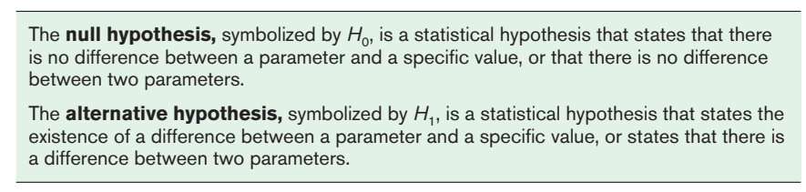
Steps in Hypothesis Testing—Traditional Method
There are two types of statistical hypotheses for each situation: the null hypothesis and the alternative hypothesis.

Slide 5

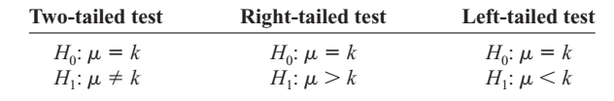
Hypothesis Testing (Contd.)
To state hypotheses correctly, researcher must translate the conjecture or claim from words into mathematical symbols. The basic symbols used are as follows:
The null and alternative hypotheses are stated together, and the null hypothesis contains the equals sign, as shown (where k represents a specified number).

Slide 6
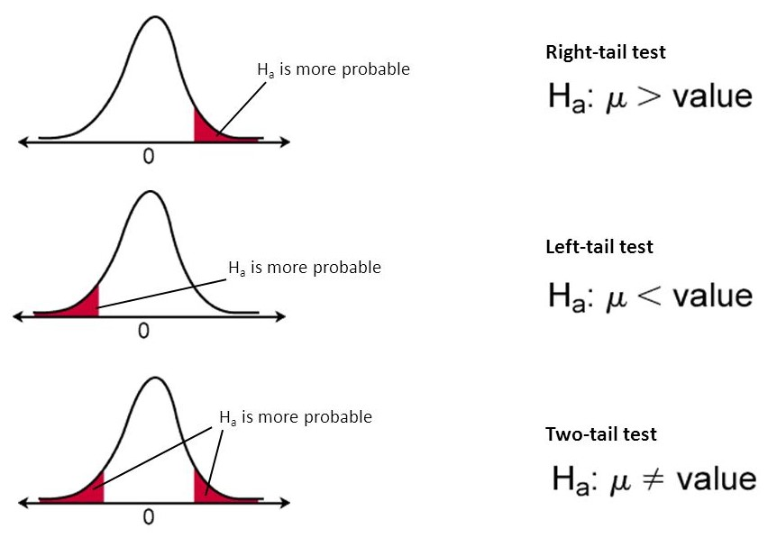

Slide 7
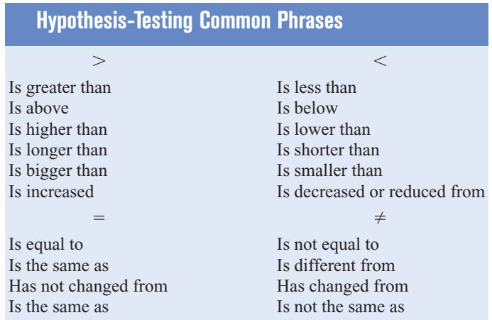

Slide 8
State the null and alternative hypotheses for each conjecture
An engineer hypothesizes that the mean number of defects can be decreased in a manufacturing process of compact disks by using robots instead of humans for certain tasks. The mean number of defective disks per 1000 is 18.
A psychologist feels that playing soft music during a test will change the results of the test. The psychologist is not sure whether the grades will be higher or lower. In the past, the mean of the scores was 73.
A real estate agent claims that 60% of all private residences being built today are 3bedroom homes. To test the claim, a large sample of new residences are inspected; the proportion of these homes with 3 bedrooms is recorded and used as out test statistic state the null & alternative hypotheses.
Notes:
Null: Mean=18 & H1: Mean <18
Null: Mean = 73 & H1: Mean not equal to 73
Null: p=0.6 & H1: P not equal to 0.6.

Slide 9

$H_{0}$ : µ= 18
$H_{1}$ : µ > 18
$H_{0}$ : µ= 73
$H_{1}$ : µ ≠ 73
$H_{0}$ : µ= 0.6
$H_{1}$ : µ≠ 0.6

Slide 10
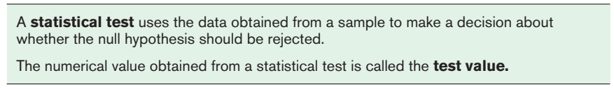
Hypothesis Testing (Contd.)
After stating the hypothesis, the researcher designs the study. The researcher selects the correct statistical test, chooses an appropriate level of significance, and formulates a plan for conducting the study.

Slide 11
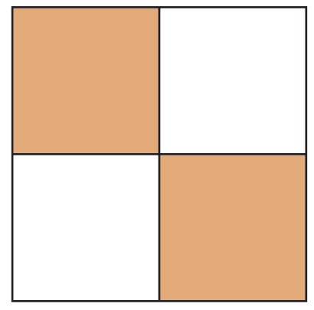
4 types of decisions
In the hypothesis-testing situation, there are four possible outcomes.
Ho True
Ho False
P(Type-I) = Level of significance
Correct Decision
Error
(Type – I)
Reject Ho
Correct Decision
Do not reject Ho
Error
(Type – II)
P(Type-II) = β
Notes:
The level of significance is the maximum probability of committing a type I error.

Slide 12
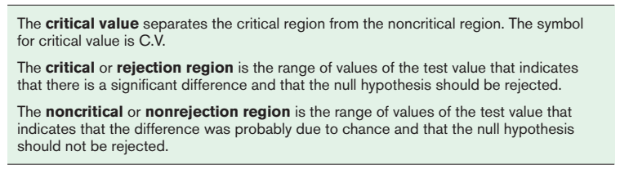
Hypothesis Testing (Contd.)

Slide 13

Hypothesis-testing situation in a Jury Trial
In a jury trial, there are four possible outcomes. The defendant is either guilty or innocent, and he or she will be convicted or acquitted.
Next, the evidence is presented in court by the prosecutor, and based on this evidence, the jury decides the verdict, innocent or guilty.

Slide 14
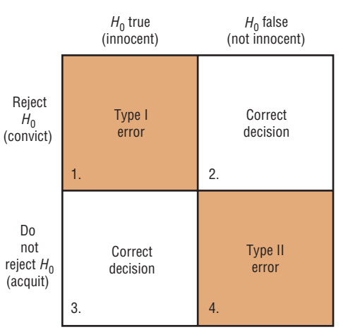
Jury trial (Results of trial)

Slide 15
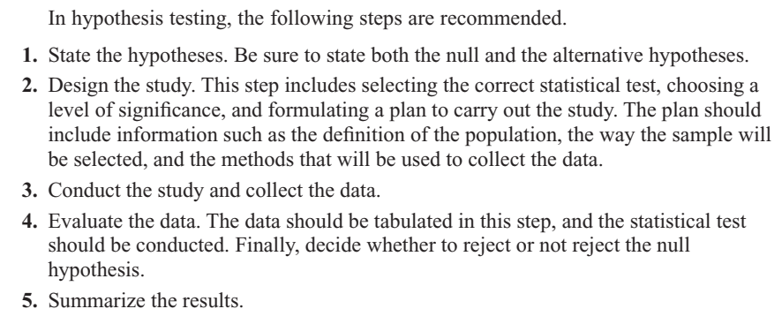
Steps in Hypothesis Testing (summary)

Slide 16
Z-test for mean
The z test is a statistical test for the mean of a population. It can be used when n > 30, or when the population is normally distributed and σ is known. The formula for the z test is

Slide 17
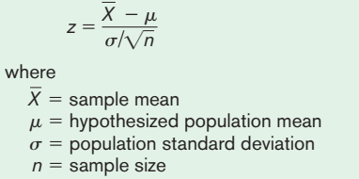

Slide 18
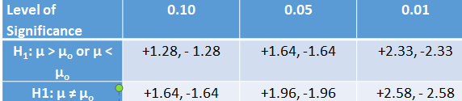
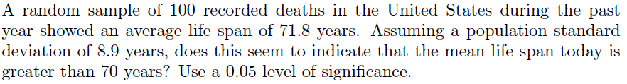
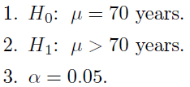
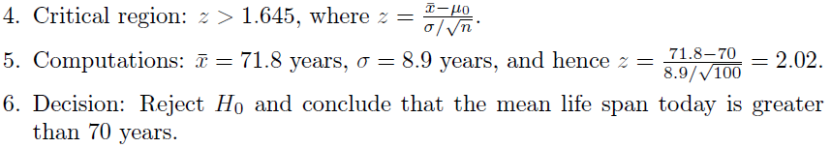
Example # 01

Slide 19
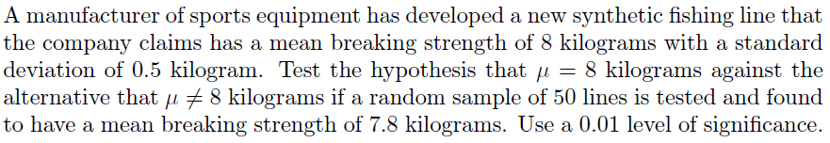
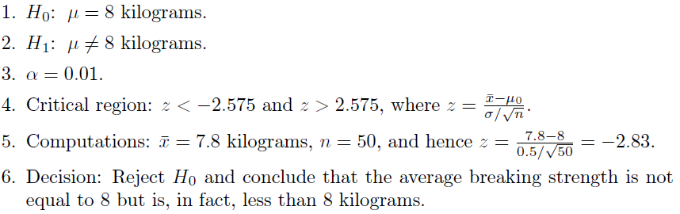
Example # 02

Slide 20
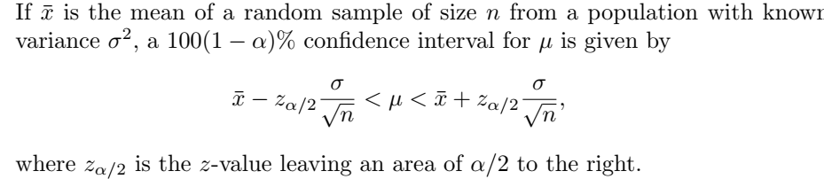
Confidence Interval on µ when σ is known

Slide 21
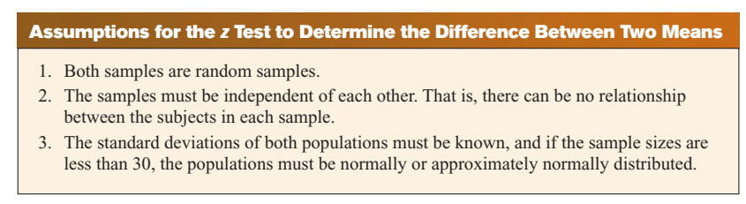
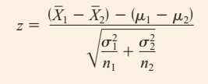
Test of Difference between two means

Slide 22
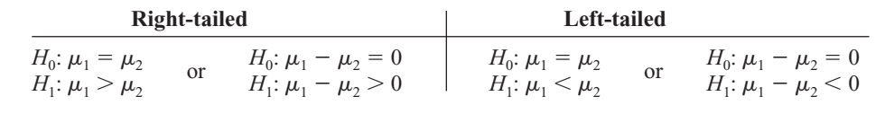
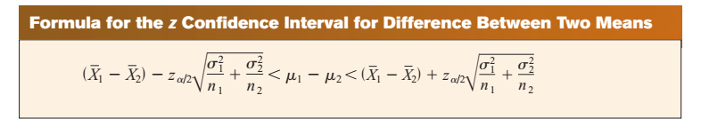
Test of Difference between two means (Contd.)

Slide 23
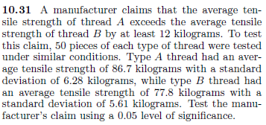
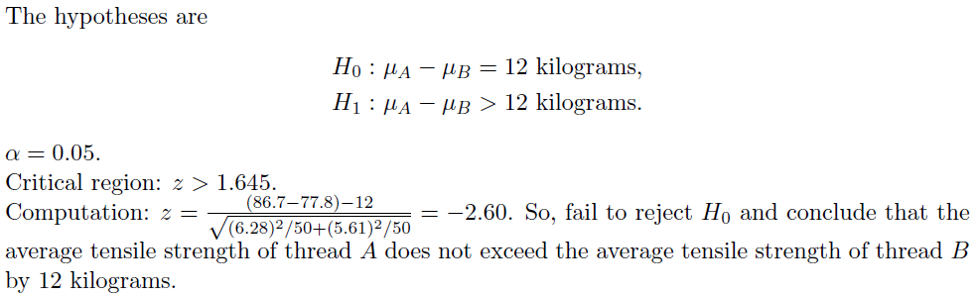

Slide 24
T-test for Means (μ)
When σ is unknown and n < 30, then z-test is inappropriate for testing of hypotheses involving means. Then t-test is used.
t-test is used when σ is unknown, n < 30, population is normally or approximately normally distributed.

Slide 25
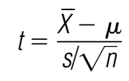
The formula for t-statistic is:
with degrees of freedom d. f. = n – 1

Slide 26
t-test for a Mean (t-distribution)
The t distribution is similar to the standard normal distribution in the following ways.
It is bell-shaped.
It is symmetric about the mean.
The mean, median, and mode are equal to 0 and are located at the center of the distribution.
The curve never touches the x axis.

Slide 27
Similarity B/w t & Std. Normal Distribution
It is bell-shaped.
It is symmetrical about mean.
Mean = Median = Mode = 0
The curve never touches x-axis.

Slide 28
Difference B/w t-distribution & Std. Normal distribution
The variance is greater than 1. [var = υ/(υ-1); υ ≥ 3]
The t-distribution is less peaked than normal distribution.
The t-distribution has greater dispersion than normal distribution with heavier tails.
The t distribution is a family of curves based on the degrees of freedom, which is a number related to sample size.
As the sample size increases, the t distribution approaches the normal distribution.

Slide 29
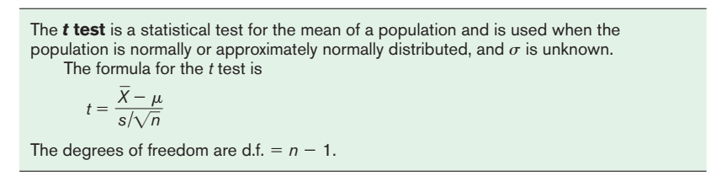
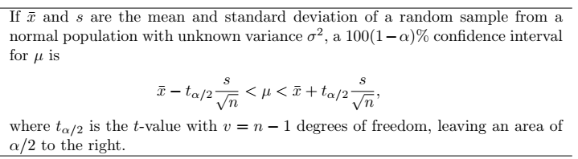
t-test for a Mean
The t-test is defined as:

Slide 30
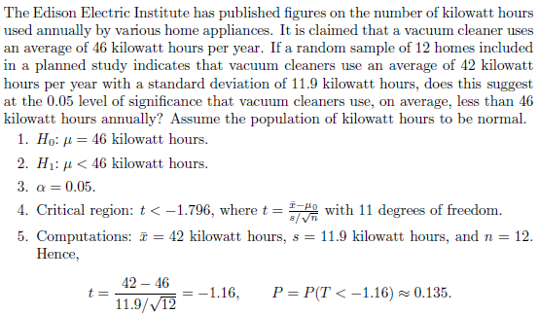

Slide 31


Slide 32
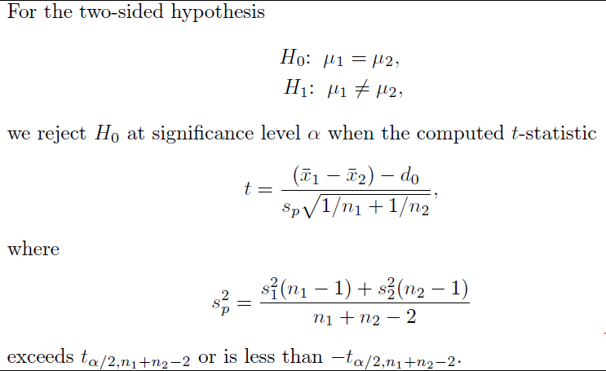

Slide 33
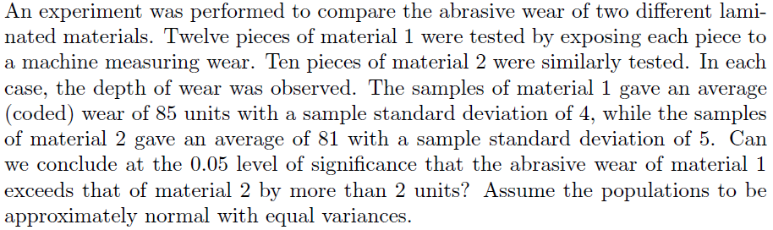

Slide 34
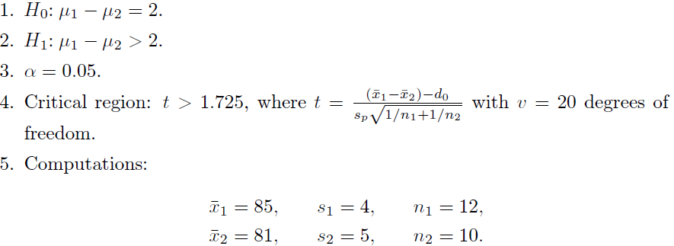
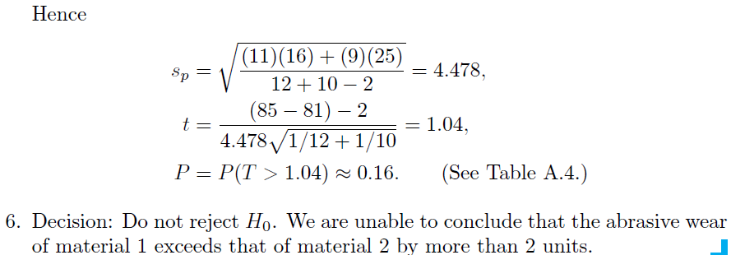

Slide 35
Testing the Difference Between Two Means: Dependent Samples
Samples are considered to be dependent samples when the subjects are paired, matched or related in some way.
Here are some other examples of dependent samples:
A researcher may want to design an SAT preparation course to help students raise their test scores the second time they take the SAT. Hence, the differences between the two exams are compared.
A medical specialist may want to see whether a new counseling program will help subjects lose weight. Therefore, the preweights of the subjects will be compared with the postweights.

Slide 36

Testing the Difference Between Two Means: Dependent Samples (Contd.)
When the samples are dependent, a special t test for dependent means is used. This test employs the difference in values of the matched pairs. The hypotheses are as follows:

Slide 37
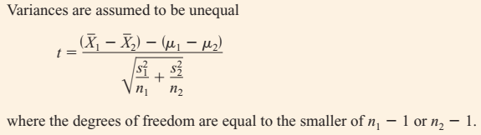
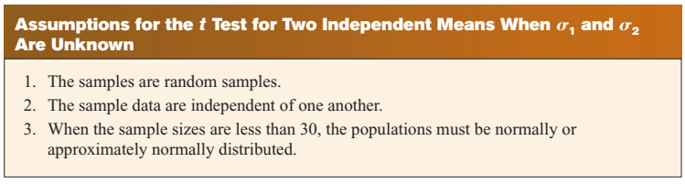
Testing Difference between two mean (Independent Sample: t-test)

Slide 38
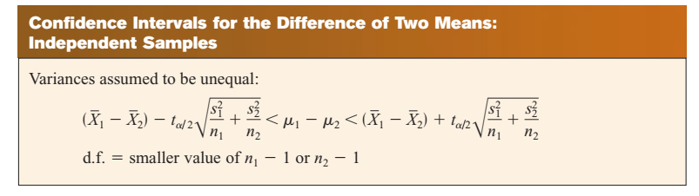

Slide 39
